Slide 1
Welcome To Our Company
The next few slides are a brief introduction to some of the lessons you will take later this week
Notes:
Good morning/afternoon everyone, and a warm welcome to the team! We are thrilled to have you join our company. As part of your onboarding journey, we want to ensure you are fully equipped for success and safety from day one. To kick things off, the next few slides will provide a brief introduction to some of the critical lessons and policies you will dive into deeper later this week. Let’s get started.

Slide 2
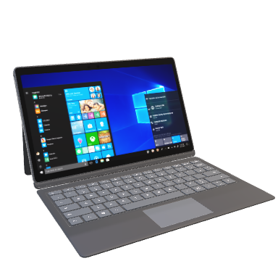


Select an image and proceed to Onboarding Day 1
Click on the icon to watch a welcome message to our company
Notes:
The center link is for Google Interns for example only

Slide 3
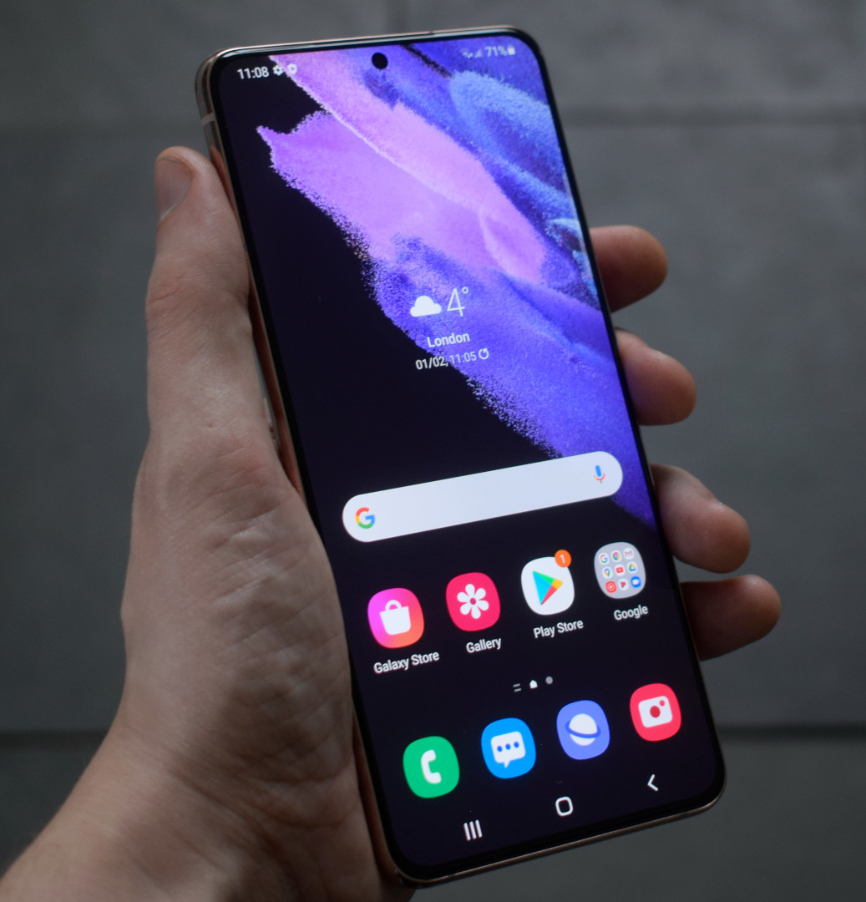
Mobile Phone Policy
If you are assigned a company phone, please use it for business purposes only.
Do not connect to public wifi networks
Keep your device on silent during all meetings, training sessions and client meetings
Recording confidential information, written or recording conversations, is forbidden
Installing or using non-work-related applications, games, or entertainment platforms that are not part of the daily job responsibilities is prohibited
Select the Home Icon to return to the main menu
Notes:
First up is our Mobile Phone Policy. Any mobile device you use that hosts corporate applications, multi-factor authentication (MFA) tools, or enterprise communication channels must strictly comply with our company's mobile configuration baselines. What this means in practice is that unapproved software modifications or bypassing application sandbox controls are strictly prohibited. Please remain vigilant regarding dynamic security updates pushed to your corporate profiles to ensure your devices stay secure.

Slide 4

Laptops-Best Practices
Do use a VPN whenever you are working from a coffee shop, airport, or any public Wi-Fi.
Do save all files to Company Cloud Storage so they are backed up if your hardware fails.
Do restart your laptop at least once a week to ensure security patches and updates are installed.
Do report a lost or stolen laptop immediately (within 24 hours) so IT can remotely wipe sensitive data.
Do keep your laptop on a flat, stable surface to prevent overheating and internal fan damage.
Do use a privacy screen if you frequently work in public spaces where others can see your monitor.
Notes:
Moving on to hardware, you are responsible for maintaining the physical and functional health of your assigned laptops. Please stick to these core best practices:
Always use a VPN when working from public Wi-Fi spaces like coffee shops or airports.
Save your deliverables directly to Company Cloud Storage to avoid data loss if your hardware fails. Local saving is restricted.
Restart your laptop at least once a week to enforce the installation of vital security patches.
Report a lost or stolen laptop immediately—strictly within 24 hours—so IT can execute a remote data wipe.
Keep your laptop on a flat, stable surface to minimize overheating and fan damage.
Use a privacy screen if you are working in public spaces where others can glimpse your monitor."

Slide 5

Laptop Practices to Avoid
Don't allow
Don't allow family members or children to use the device for schoolwork, gaming, or browsing.
Don't download
Don't download unauthorized software, browser extensions, or pirated media.
Don't keep
Don't keep your passwords on a sticky note attached to the laptop or inside the laptop bag.
Don't eat or drink
Don't eat or drink directly over the keyboard—liquid damage is one of the most common (and expensive) repairs.
Don't check
Don't check the laptop in as luggage when flying; always keep it in your carry-on to prevent theft or rough handling.
Notes:
Now that we’ve covered what to do, we will also be dedicating time later this week to talk about what not to do. This upcoming section will highlight common mistakes and bad habits—such as leaving devices unattended in vehicles or clicking unverified links—that put our company network and your physical hardware at risk. Keep an eye out for this full session in a couple of days.

Slide 6
Internet Security and Safety
Phishing Awareness: Always verify the sender’s full email address before clicking links or downloading attachments. Look for "red flags" like urgent threats, poor grammar, or slightly misspelled domain names.
Sensitive Data: Never send unencrypted sensitive information (passwords, social security numbers, or client financial data) via email. Use the company’s secure file-sharing portal instead.
Password Strength: Use "passphrases" rather than simple passwords (e.g., Blue-Coffee-Runs-4-Miles!). Passwords must never be reused across multiple accounts
Multi-Factor Authentication (MFA): MFA is mandatory for all company accounts. Never share or approve an MFA prompt that you did not personally trigger.
Notes:
This brings us to a broader, crucial topic: Internet Security and Safety. Protecting our company's perimeter requires proactive and vigilant risk management from every single one of us. Technology can only catch so much; you are our strongest line of defense against cyber threats. Let's look at a quick refresher on how to spot a primary cyber threat: phishing.

Slide 7
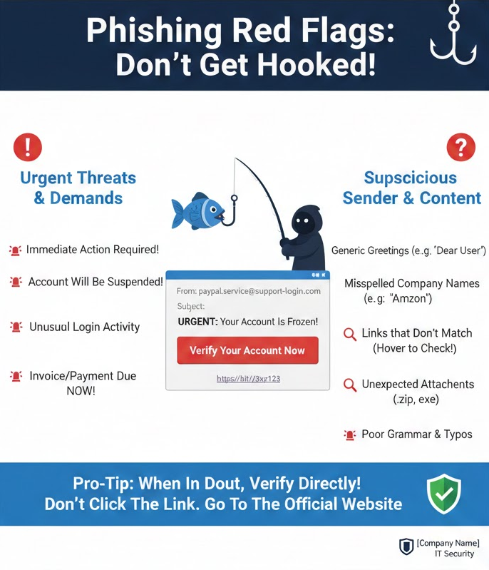
A Quick Review of Phishing Red Flags
Notes:
A Quick Review of Phishing Red Flags. Phishing Red Flags: Don’t Get Hooked!" Infographic detailing urgent demands, suspicious senders, hovering over links, and payload inspection
Please pay close attention to these phishing red flags to ensure you don’t get hooked:
Watch out for urgent threats and demands: Be highly critical of high-pressure emails demanding immediate action, quick invoice payments, or credential verifications.
Inspect the sender: Meticulously check email domains for subtle typos—like spelling it 'Amzon' instead of 'Amazon'—and watch out for generic greetings.
Hover before clicking: Always hover your mouse over embedded web links to inspect the destination URL before clicking.
Inspect payloads: Never open unexpected external attachments, especially compressed archives or executable files like .zip or .exe.
Pro-Tip: Remember, when in doubt, verify directly! Do not click the link; go straight to the official website or contact the IT Security Desk.

Slide 8

Rules of Business (ROB)
Signing the ROB, electronically, confirms you have received training on the company’s business conditions which are guidelines, policies, and constraints that define or restrict an organization's operations. They are designed to ensure consistency, compliance, and efficiency in decision-making and processes across the entire organization.
Notes:
Rules of Business (ROB). Signing the ROB, electronically, confirms you have received training on the company’s business conditions which are guidelines, policies, and constraints.
The foundation of all these security and operational expectations is called the Rules of Business, or ROB. The ROB defines the guidelines, policies, and operational constraints that govern our daily activities. They are meticulously engineered to guarantee maximum consistency, data compliance, and operational efficiency across all of our distributed teams. Later this week, you will be required to electronically sign this document to confirm you have received this training and understand these boundaries.

Slide 9
Rules of Business (ROB) Agreement
Corporate Standards, Guidelines, and Operational Constraints
The Rules of Business (ROB) define the foundational guidelines, policies, and operational constraints that restrict or govern our organization’s daily activities. These standards are engineered to guarantee maximum consistency, data compliance, and operational efficiency across all distributed teams and technology implementations.
Purpose & Scope
This document applies to all corporate employees, contractors, and third-party stakeholders utilizing company-issued assets or accessing corporate environments. Compliance with these directives is mandatory to protect institutional data integrity and mitigate operational risk.
Laptop & Hardware Best Practices
Employees are responsible for maintaining the security and functional health of all assigned mobile computing assets. The following controls must be adhered to at all times:
  Virtual Private Network (VPN): You must establish a secure VPN connection whenever working from a public network, including coffee shops, hotels, airports, or any unsecured Wi-Fi.
  Cloud Storage Compliance: All corporate and client deliverables must be saved directly to Company Cloud Storage. Local hardware saving is restricted to prevent loss during hardware failures.
  System Lifecycle Maintenance: Laptops must be restarted at least once per calendar week to enforce immediate installation of scheduled software, operating system, and security patches.
  Physical Asset Protection: Hardware must remain on flat, stable surfaces during operation to minimize thermal buildup and internal fan friction. When operating in public view, privacy monitors/screens must be utilized.
CRITICAL INCIDENT REPORTING REQUIREMENT
In the event of a lost or stolen company laptop, tablet, or cellular device, you must report the incident to the IT Security and Incident Response Desk immediately—strictly within twenty-four (24) hours. This swift notification allows enterprise administrators to execute remote data wipes and isolate the hardware to protect sensitive network infrastructure.
3. Mobile Phone & Portable Device Policy
Mobile devices hosting corporate applications, multi-factor authentication (MFA) systems, or enterprise communication tools must comply with corporate mobile configuration baselines. Unapproved software
Notes:
To wrap up our preview, here is a look at the formal ROB agreement document you will review. It applies to all employees, contractors, and third-party stakeholders utilizing company assets. By executing your electronic signature on this document at the end of the week, you explicitly confirm that you have received this training, fully comprehend the rules, and agree to remain bound by our information security policies. Thank you for your commitment to keeping our company secure—let's open up the floor to any initial questions before our deep dives later this week.

Slide 10
modifications or bypassing application sandbox controls is strictly prohibited. Users must remain vigilant regarding dynamic security configuration updates pushed to their corporate profiles.
Internet Security & Threat Awareness
Protecting the enterprise perimeter requires proactive vigilant human risk management. Staff must actively look out for phishing and social engineering indicators before interacting with links or attachments:
  Urgent Demands: Be highly critical of high-pressure communications demanding immediate administrative actions, credential verifications, or rapid invoice processing.
  Sender Verification: Meticulously review sender email domains for subtle typographical alterations (e.g., misspelled brand or company names). Generic or contextually detached greetings indicate malicious intent.
  Payload Inspection: Hover over embedded web links to verify destination URLs prior to clicking. Do not open unexpected external attachments, specifically archived fields or executable types (.zip, .exe).
5. Employee Acknowledgment & Binding Sign-off
By executing an electronic or physical signature below, I explicitly confirm that I have received comprehensive training regarding the company's Rules of Business (ROB). I attest that I read, fully comprehend, and agree to remain bound by the operational constraints, compliance criteria, and information security policies outlined herein.
EMPLOYEE PRINT NAME
EMPLOYEE SIGNATURE
EMPLOYEE ID / DESIGNATION
DATE SIGNED
Notes:
Please download the form and sign it and upload to our secure server.

